Slide 1
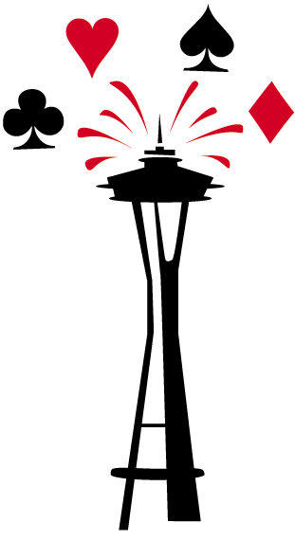

Seattle ACBL Unit 446 invites you to our
Knockout (KO) Sectional
May 26-29, 2023
Tournament Chairs
Tom Brown: tbrown1200@comcast.net
Mirjana Reams: mirreams@gmail.com
Director in Charge
Jenni Carmichael
Day of Tournament Phone: 303-601-2841
LOCATION & DIRECTIONS
Shoreline Community College, 16101 Greenwood Ave N, Shoreline, WA 98133
Pagoda Student Union Bldg. Use main entrance and follow signs
https://bridgeinseattle.org/2023-KO-sectional
SCHEDULE
Friday May 26th
1:30 pm 0-750 Stratified Pairs (single session)
Open Stratified Pairs (single session)
7:00 pm 0-750 Stratified Pairs (single session)
Open Stratified Pairs (single session)
Saturday, May 27th
10:30 am 0-750 Stratified Pairs (single session)
Open Stratified Pairs (single session)
0-2500 Bracketed KO (round 1 of 3)
Mini-Soloway KO: 2-Session Qualifying Swiss (1/4)
3:30 pm 0-750 Stratified Pairs (single session)
Open Stratified Pairs (single session)
0-2500 Bracketed KO (round 2 of 3)
Mini-Soloway KO: 2-Session Qualifying Swiss (2/4)
Sunday, May 28th
10:30 am 0-750 Stratified Pairs (single session)
Open Stratified Pairs (single session)
0-2500 Bracketed KO (round 3 of 3)
Mini-Soloway KO: Semi-Finals (3/4)
3:30 pm 0-750 Stratified Pairs (single session)
Open Stratified Pairs (single session)
Mini-Soloway KO: Finals (4/4)
Monday, May 29th
10:30am A/X Swiss (2 sessions)
& TBA 0-2500 Bracketed teams (2 sessions)
________________________________________________
Strats: 0-750: 0-200, 200-500, 500-750
Open: 0-1250, 1250-3000, 3000+
A/X Swiss Teams 0-3000, 3000+
Stratification is based on the average MPs of the pair/team, but no player may exceed the upper limit of limited events. Limited events subject to minimum attendance.
“MINI-SOLOWAY” KO
Rounds 1 & 2 run as a 2-session Swiss (Saturday)
Top 4 teams qualify for the Sunday semi-finals (no carryover), and the top qualifier chooses from the 3rd & 4th place teams for their semi-final opponent
What’s Great: Entrants are guaranteed a full day of play on Saturday, no “unlucky” first round draws, try a “mini” version of the NABC Soloway KO event
NEED A PARTNER OR TEAM?
GET MATCHED UP
Email sbu446partnership@gmail.com, and we’ll try to match you up (checked ~3 weeks before event).
________________________________
Covid Protocols
Proof of vaccination required. See ACBL “Covid Protocols for National, Regional and Sectional Tournaments”: www.acbl.org/covid-protocols/
________________________________
Entry Fees
100% cashless entry payment
Adult ACBL Member (26+) $12 per session
Youth ACBL Member (under 18) $2 per session
Junior ACBL member (18-25) $6 per session
More information at: https://bridgeinseattle.org/entry-fees
Coffee and light hospitality provided for all sessions. Meals are not provided.
Website: http://bridgeinseattle.org
Facebook: http://facebook.com/SeattleBridge/

