Slide 1

CEO Report (August 2017)
September 1, 2017
Bahar Gidwani

Slide 2
Cleaning Up, Getting Ready
Staff identified and organized a list of ideas and problems. Each area committed to addressing several items. We completed more than 40 projects during August.
At the same time, staff worked on 14 “big ideas” that could contribute to ACBL’s long-term success.
Staff has now narrowed this to 10 big ideas. It plans to present these ideas to the Board during the second wee of September.

Slide 3
Projects Spanned Five Areas
Area | Projects
Finance | 10
Governance | 11
Marketing | 7
Operations | 12
Technology | 6
Total | 45
Employee and legal issues are included in “Governance.”
Staff continued to respond to questions and to handle all other “normal” activities.

Slide 4
Finance Projects
Checked terms of various vendor contracts—found one place we could get extra benefits and two contracts we need to pre/renegotiate.
Completed an environmental review of our building. Found potential cost savings we plan to present to Finance Committee.
Created a new easier-to-understand cover page for our monthly finance report.
Cut list of people who will go to San Diego to 16 from 22 (rooms nights down to 171 from 247, a 31% reduction)

Slide 5
Finance Projects—cont.
Reviewed rules for recapture of expired Bridge Bucks (our treatment has been correct).
Separated TD training expenses from normal costs (will be reflected in 4Q reports).
Built a rollout plan for change to Canadian dollar fees in Canada and shared it with our Canadian Board members.
Made chart of cash position over time. (See following page.)
Sought details on District and tournament financials. (See page after next.)

Slide 6
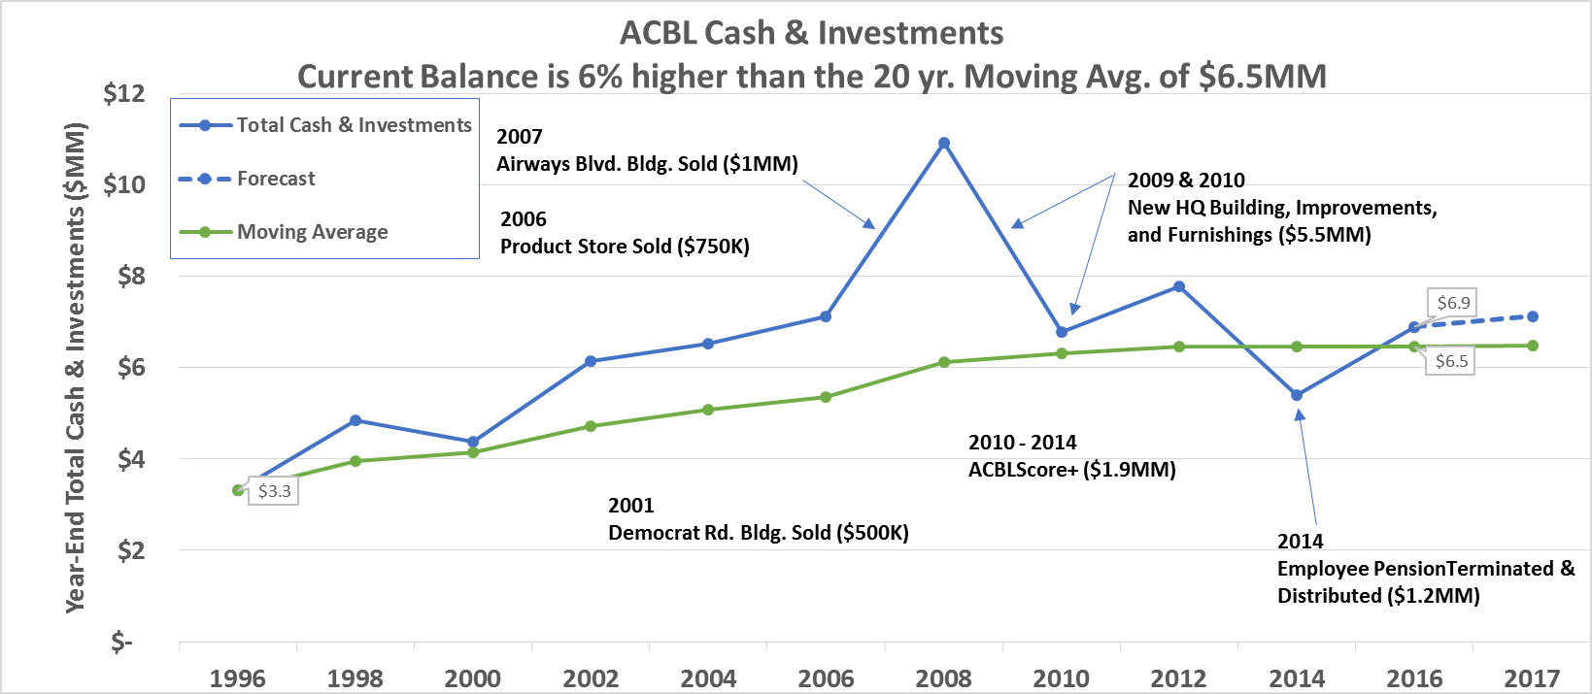
Finance Projects—Cash Over Time
Some parties have the impression that ACBL is in financial distress.
In fact, our cash position is extremely strong and has improved over the past several years.

Slide 7
Finance Projects—District Financials
The Board agreed in Toronto that we could study district and tournament financials. We hope to understand ACBL’s overall cash flow and improve best practices for all parts of ACBL.
Unfortunately, we have received data from only 13 districts. 5 have given various reasons they can’t share data with us. 7 haven’t responded at all.
We have reached out directly to each district’s treasurer. We plan next to go back to Board members from districts that have not responded and ask for help with this project.

Slide 8
Governance Projects
Cleaned up BoG email list. Can now reach them all.
Hired a national recorder. Robb Gordon. Added member to ACC.
Issued/improved several staff policies:
  NABC compensation days.
  “Sandwich” holidays.
  Appropriate dress.
  Work at home.

Slide 9
Governance Projects—cont.
Published CDR and asked for comments.
Released new convention chart proposal and asked for comments.
Researched WBF zonal governance.
Provided support to Las Vegas unit.
Wrote license for use with groups who want to use ACBL trademarks. (E.g., will apply if WBF wants to grant WBF Masterpoints in Orlando in 2018)

Slide 10
Marketing Projects
Analyzed effect of Toronto’s Robot Game (attached separately).
Built and announced a partnership with Ed Fund to expand the Collegiate Bowl (details attached).
Posted job for in-house PR coordinator and customer experience manager.
Announced hotel cancellation fees for San Diego NABC.

Slide 11
Marketing Projects—cont.
Started process to expand club service hours:
  Current 8-5 weekday-only hours do not meet needs of clubs.
  We will use a new 800 number and a reprogram of our phone system to expand our hours of service to both clubs and tournaments.
  First test will be week of September 11.
  Full rollout may occur by end of month.

Slide 12
Marketing Projects—cont.
Newcomer survey (0-5 masterpoints):
  23,000 members have 0-5 points.
    Online survey sent to 18,000 newcomers. 2,200 responded.
    ~2,500 do not want email. ~2,500 have no email on file.
    Called 680 without emails: 77 survey responses and emails recovered.
Called 1,460 lapsed members in August. ~ 100 renewals resulted

Slide 13
Marketing Projects—cont.
Installed new Customer Relationship Management (CRM) software.
Named CRM project manager: Carol Robertson. Carol leads a cross-functional team from accounting, IT and marketing.
Scheduling training of ACBL staff.
Studying migration of data from AS/400 into the new CRM.

Slide 14
Operations Projects
Clarified that all tournament DiCs must be ACBL employees.
Offered support to two “troubled” tournaments. Both appear to be fine.
Diagnosed source of some scoring, seeding, and other issues at Toronto NABC and shared report with players.
Found 140 more rooms for San Diego NABC, without exposure to attrition.

Slide 15
Operations Projects—cont.
Launched second employee survey—field employees (see attached results).
Supported Anti-Cheating Committee
  Offered contract to video support person.
  Invited another player to join committee.
  Delivered player memos from Toronto.
  Reviewed procedures for working with other organizations.

Slide 16
Operations Projects—cont.
Publicized anti-vaping policy.
Researched ABA masterpoint integration issue. Hope to publish a firm conversion ratio in September.
Set standard for tables / TD (15 - 20).
Shared BBO contract terms with Districts and units (will help avoid conflicts with our BBO agreement).

Slide 17
Operations Projects—cont.
Collaborated with Tournament Task Force (TTF) on short term fixes for tournament attendance decline.
Received TTF input (attached markup).
After Board reviews and comments, Staff will start implementing items in September and October.
Some items will require Board action in San Diego.

Slide 18
Technology Projects
Reviewed Board Office 365 email issues. Resolved them and confirmed the system works.
Upgraded all of HQs computers. Rolling out an upgrade to all TDs.
Tested a “director call” feature on Bridgemates. Found some problems with it, but we may be able to fix them.

Slide 19
Technology Projects—cont.
Developed an electronic ticket purchase solution.
  Players will be able to buy tickets for some events in Tunica using a credit card.
  TDs will see these “reservations” and be able to integrate them into their games.
  Extra fees will be absorbed by ACBL.
Next test will also include advance, on-line purchase.

Slide 20
Technology Projects—cont.
Made progress on new KO/Swiss game management system.
  Uses Bridgemates to record player information and direct movement.
  Integrates with projector display system (so players can easily track progress).
  Tested Swiss in Milwaukee.
KO should be ready and tested before Charlotte regional. Hope to use whole system in San Diego.

Slide 21
Technology Projects—cont.
Completed some aspects of game file ingestion and validation system.
Completed most of club pair game parts of masterpoint engine.
We are working towards supporting new game management scoring engines that can replace ACBLScore.
Expect to test and certify at least two new engines by end of year.

Slide 22
Financial Effects of August Activity
Change ($ Added or Lost) | Rough $ +/- Vs Baseline
 | 2017 | 2018
Hotel cancellation policy | +7 | +21
Expanded Collegiate Bowl | -15 | -30
Hire National Recorder | +48
Cut staff travel to NABC | +20 | +60
More generous holiday policy |  | -17
Shift PR in-house | -3 | -39
E-ticket (advance and at tourn) | -5 | -20
Upgrade HQ computers | -37
Support Las Vegas | -9
Total | -4 | -25
Note: Baseline in 2017 is driven by budget and experience to date. For 2018 it is driven by a comparison with 2017.

